Slide 1

Go (Golang)
The basics…
Mikael Berglund 2024-03-21

Slide 2

Index
About
For what
Pros and cons
Install
Hello world
Debug
Build
Importing 3rd party packages
Variables
Data types
Packages
Private/Public
Go routines
Panic
Defer (try/catch)
Recover
Normal error handling
Channels
Select
Waitgroup
Leakage
Context
Embed
Inheritance
Polymorphism
Other

Slide 3
About
Created by Google 2007
Sometimes called Golang
Syntax that builds on C
Statically typed
Garbage collecting
Parallell thread execution
Code in VsCode

Slide 4
For what?
Programs that must scale
Programs that need effective thread execution
Development on one OS, build to several
Cloud-programs
Performance critical applications
Applications with limited memory resources

Slide 5
Pros and cons
Pros
Install/develop on Windows, Mac, Linux
Cross compiling (builds everything to one binary)
Known for its incredible performance (efficient runtime, garbage collection and compiled to machine code)
Known for its great memory efficiency (small footprint)
Very easy thread handling
Easy to learn (few commands)
Clean syntax

Slide 6
Pros and cons
Cons
Not object oriented (no classes, but structs)
No default values on function arguments,
func test(a:=””) does not work.
No overloading of functions (two functions, with different amount of arguments, cannot have the same name)
If you import a package that uses, for example, the package name “nats”, you cannot also declare a function in your code called “nats”.
You cannot compile, or run, your program if you have any declared variable that is not used.
By default when saving, auto format of your code is applied. This means that all unused imports will just be deleted. It means that you cannot save your work until you have completed using your imports.
No try/catch

Slide 7
Install
Download here: https://go.dev/dl/
Follow instructions: https://go.dev/doc/install

Slide 8
Hello world
$ mkdir hello
$ cd hello
$ go mod init example/hello
When you execute the last command, it will create a go.mod file in your hello folder. The go.mod file will contain information about which 3rd party modules you import into your program, together with their version.
After “go mod init” you shall enter the name that you want for your own module, in this case ”example/hello”. Normally you will save your module to a repo like github.com/hello. In that case you would name your module after this, like: go mod init github.com/hello. Others could then import your code with this name.
$ cat go.mod
module example/hello
go 1.21.1

Slide 9
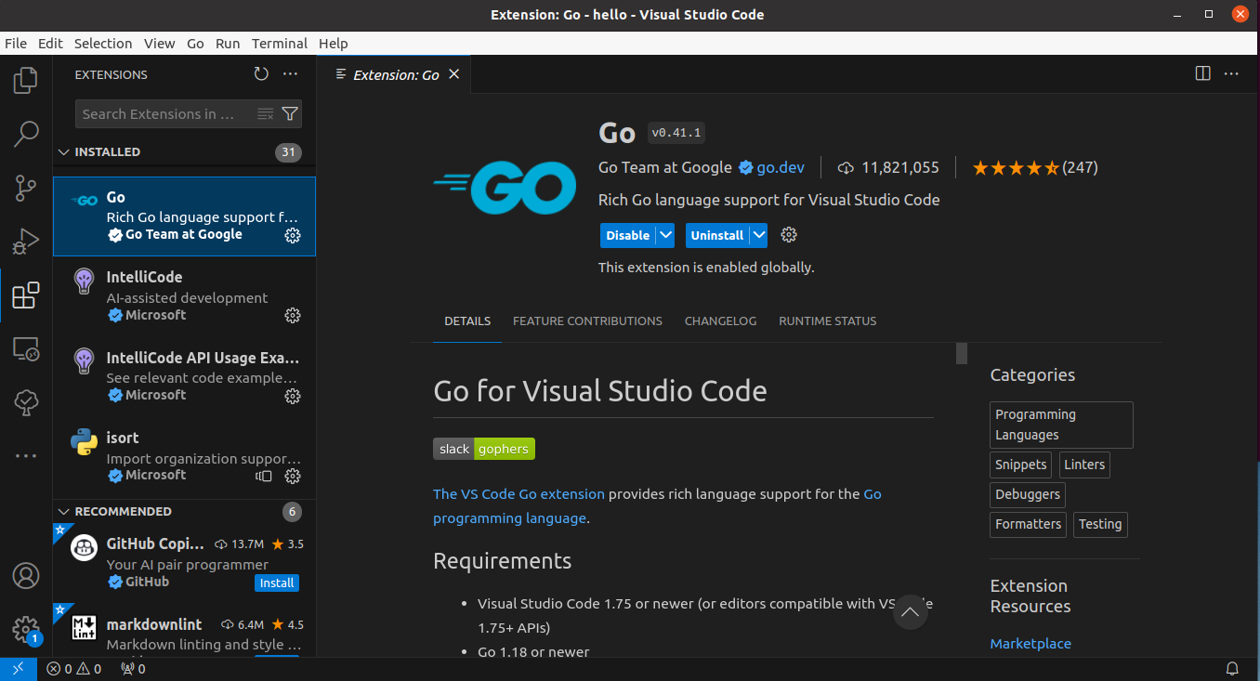
Hello world
Open VsCode and install the Go extension

Slide 10
Hello world
Create a file ”hello.go” in your hello folder and insert the following text
hello.go
package main
import "fmt"
func main() {
fmt.Println("Hello, World!")
}

Slide 11
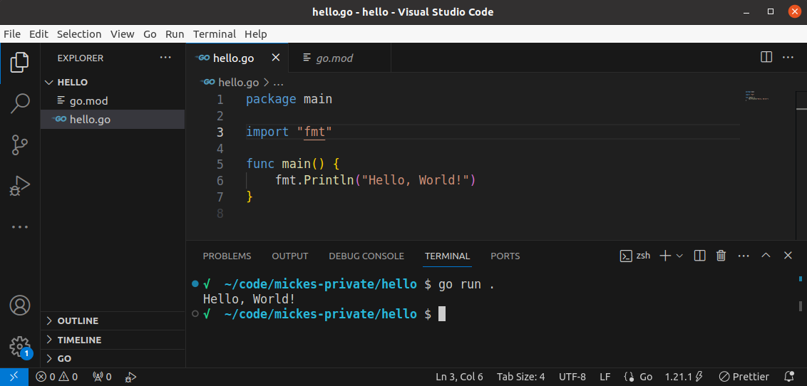
Hello world
Run the program in the terminal by:
$ go run . (or ”go run hello.go” to only include this specific file in the execution)

Slide 12
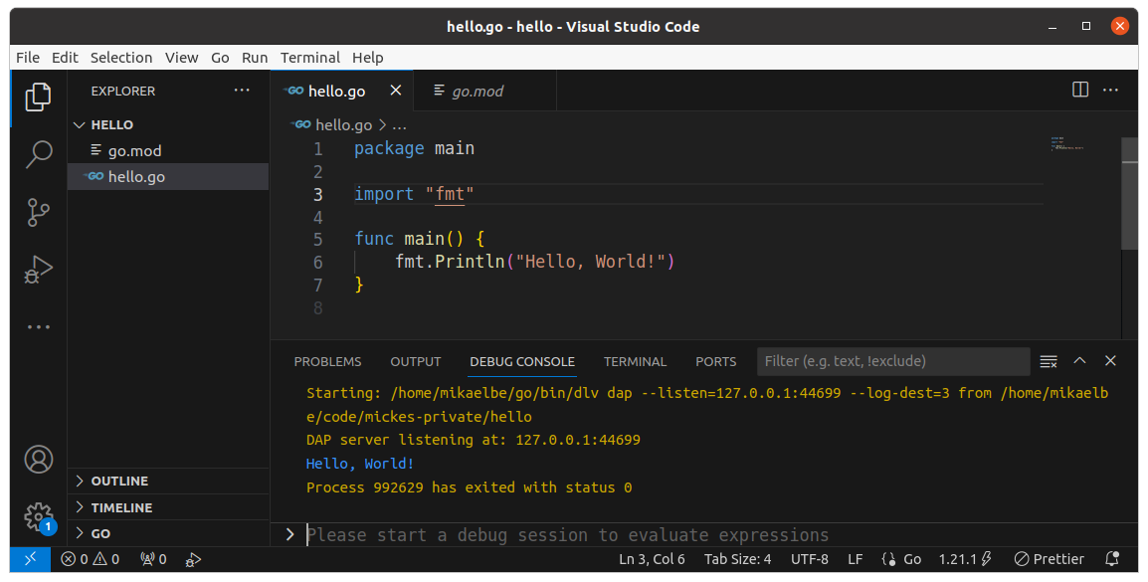
Hello world
You can also run your program by Ctrl+F5, or by the menu Go→Run Without Debugging. It will then execute the file that is currently in focus. Note, if you run your program this way, it will not send the print to the terminal but to the ”DEBUG CONSOLE”.

Slide 13
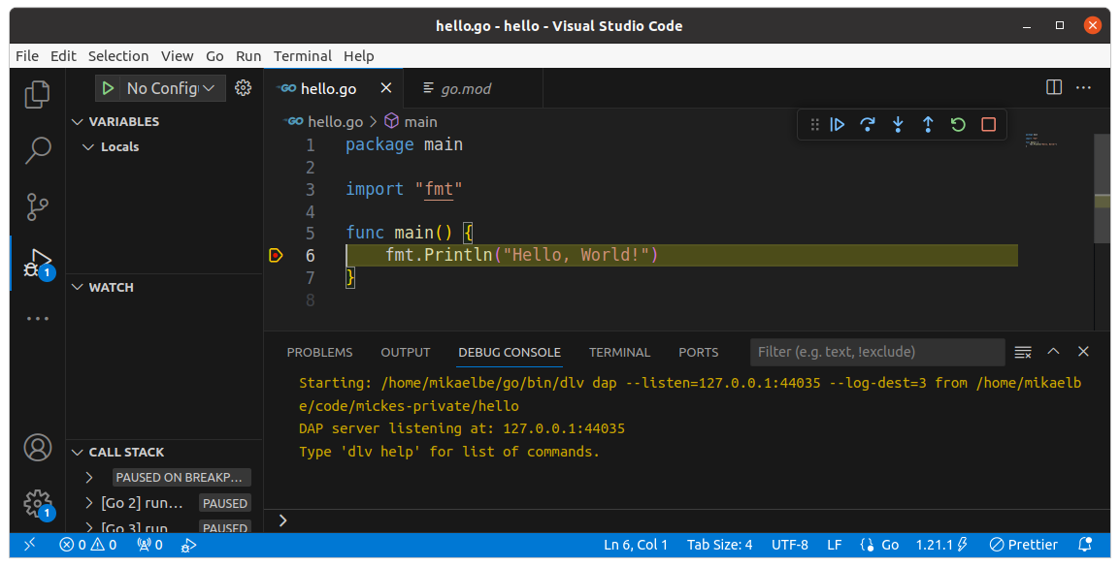
Debug
Put a breakpoint by clicking to the left of a code line so a red dot appears. Then press F5, or from the menu choose Go→Start Debugging. The execution will stop at your breakpoint. Note that it is the currently active file that will be executed.

Slide 14
Build
You build your program to an executable from the terminal. Here are some build command examples:
// Builds an executable for the OS you are in. It gets the same name as your source file containing main().
$ go build
// Define another name of your output executable
$ go build -o myExecutable
// Build executable for Windows
$ GOARCH=amd64 GOOS=windows go build -o ./bin/myProg.exe
// Build executable for Linux
$ GOARCH=amd64 GOOS=linux go build -o ./bin/myProg
// Build executable for MacOS
$ GOARCH=amd64 GOOS=darwin go build -o ./bin/myProg
// Change path to cmd/Main before building
$ go -C cmd/Main build
# Use build flags (Ex of two build flags in a src file: //go:build Mickes || Calles)
$ go build -tags Mickes
# If not using -trimpath the whole absolute path to your files will be visible in logs. This is the path to
# the files on the computer that you built your executable from. This does not look nice in a prod build.
$ go build -trimpath

Slide 15
Build
One thing to note is that if you have several source files in the main package, and your main file is using functionality from the other files, you will need to include all of the used files in your build command. But normally you don’t specify a single file, like ”go build main.go”, but instead just do ”go build” which will include all files in the current folder.
Files that you import from other packages are declared in your main file so those will be included by the compiler automatically.
// Build three files
$ go build main.go helpers.go constants.go
// Build all files in current folder
$ go build .
// Same as above (Note that for the run command you cannot exclude the .)
$ go build

Slide 16
Build
You can overwrite source variable values during the build step. To do this you add the build flag -ldflags.
For this to work the variable name must start with a capital letter (public variable).
In the below example we overwrite the ”Id” variable, that is located in the example/hello/pkg/helpers package, to 5 and the ”Name” variable to ”Micke”.
$ go build -ldflags "-X 'example/hello/pkg/helpers.Id=5' -X 'example/hello/pkg/helpers.Name=Micke'”

Slide 17
Install
Install your program so you can run it directly from your terminal:
Binary files: If you install a main program (a program containing a main function), the go install will generate an executable binary file and put it in $GOPATH/bin.
Packet files: If you install a non main program (a program not containing any main function), the go install will generate a package file (.a) and place it in $GOPATH/pkg.
$ go install

Slide 18
Importing 3rd party packages
Search for packages here: https://pkg.go.dev/
Example: https://pkg.go.dev/rsc.io/quote/v4
You can see all available functions on its page.
Update your code to use its Go() function.
package main
Import (
"fmt"
"rsc.io/quote"
)
func main() {
fmt.Println(quote.Go())
}

Slide 19
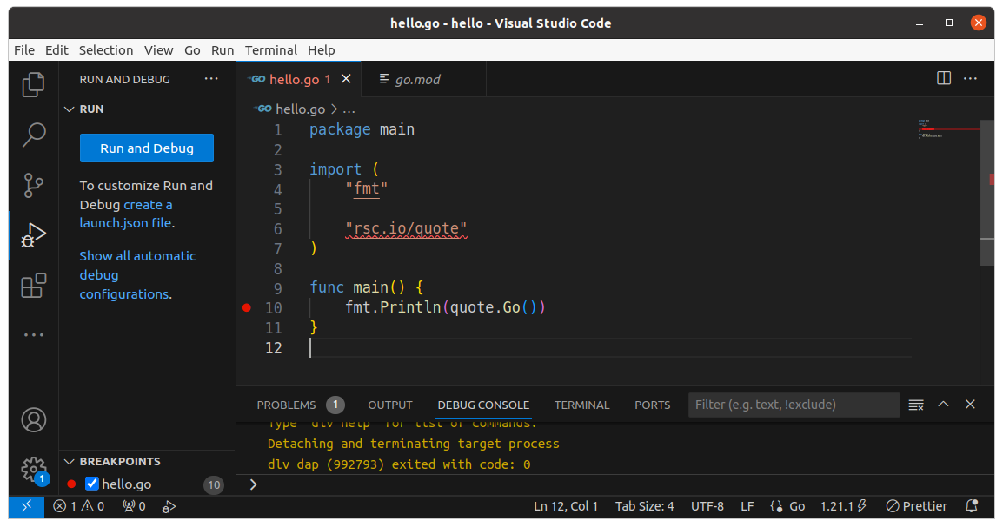
Importing 3rd party packages
In VsCode it would now look like below. As you can see VsCode does not recognize rsc.io/quote.

Slide 20
Importing 3rd party packages
To make the wanted packages available in your program you should run the following command in your terminal.
This will declare your used packages into your go.mod file and also create a go.sum file, see files on next slide. It will also remove unused packages from both go.mod and go.sum.
After this the functions in your imported packages can be freely used in your code where you imported it.
When you ran go mod tidy, it located and downloaded your wanted rsc.io/quote module, into the module cache. By default, it downloaded the latest version.
It also computed checksums for the downloaded packages and stored those to the go.sum file. This is used during building to verify that the imported packages have not been tampered with since you downloaded them.
$ go mod tidy

Slide 21
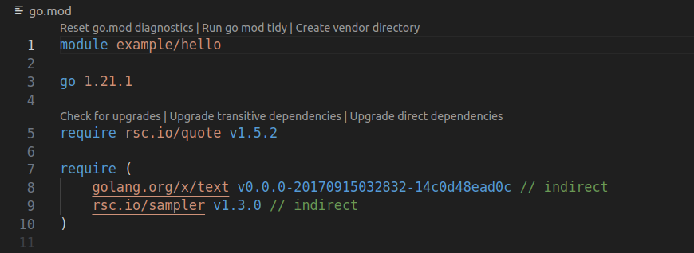
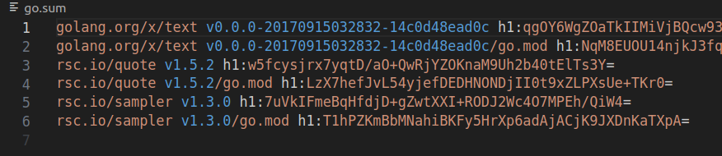
Importing 3rd party packages

Slide 22
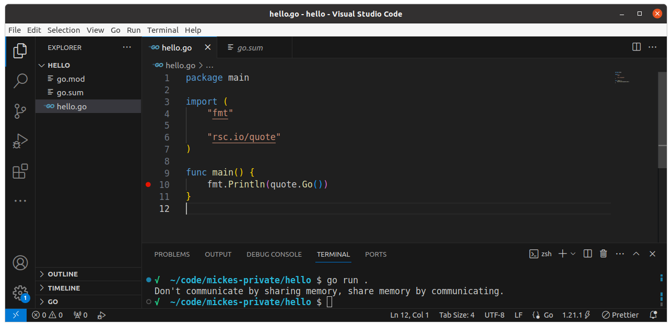
Importing 3rd party packages
Run your new code...
It just prints: ”Don’t communicate by sharing memory, share memory by communicating”.

Slide 23
Importing 3rd party packages
One thing that is special with Go is that the compiler does not allow you to import a package that you are not using. If you try to do this the package will be automatically removed when you save your go file.

Slide 24
Subfolders
To make those demos easier we will now split each demo into subdirectories and call each demo file ”main.go”. Note that subdirectories shall not contain any space character.
You will then run them by the command:
go -C <FOLDER> run main.go
and build with
go -C <FOLDER> build main.go

Slide 25
Variables
Go is ”statically typed” which means you’ll have to declare the types of all variables and the type cannot change. The compiler warns you if you try to assign something of the incorrect type, like an int to a string variable.
The compiler also warns you of declared but unused variables. You cannot even run a program with a declared unused variable.
Initialization with ”:=” or with ”=”.
”:=” only works within a function scope, outside in global scope you must use ”=”.

Slide 26
Variables
a := ”Hello world”
This lets the Go compiler automatically declare the variable ”a” to the correct type and initilizes ”a” to the string ”Hello world” in one line.
var a string
a = ”Hello world”
Lets you declare the type of ”a” and initializes it to the string ”Hello world”
a, b, c := 1, ”Hello world”, 3
var a, b, c int = 1, 2, 3

Slide 27
Data types
bool
string
int, int8, int16, int32, int64
uint, uint8, uint16, uint32, uint64
float32, float64
complex64, complex128 (complex numbers like 3+4i)
byte
rune (motsvarar char i c)
error

Slide 28
Data types
Arrays
Predefined length.
Can contain different values if declared with type ”any” (alias for interface{}).
var a [3]string = [3]string{"Kalle", "Ada", "Lisa"}
var a [3]any = [3]any{"Kalle", 1, "Lisa"}
a = append(a, ”Micke”) // Does not work for arrays!!!
Slices
Dynamic length
Can contain different values if declared with type ”any”.
var a []int = []int{10, 20, 30, 40}
var a []any = []any{"Kalle", 1, "Lisa"}
a = append(a, 50)

Slide 29
Data types
Structs
type Employee struct {
firstName string
lastName string
age int
}
func (e Employee) printFullName() {
fmt.Printf("Employee full name is %s %s", e.firstName, e.lastName)
}
func (e *Employee) changeName(name string) {
e.firstName = name
}
emp1 := Employee{
firstName: "Sam",
age: 25,
lastName: "Anderson",
}
emp2 := Employee{"Thomas", "Svensson", 29}
emp2.printFullName()
emp2.changeName(”Kalle”)

Slide 30
Data types
Maps
make(map[type of key]type of value)
employeeSalary := make(map[string]int)
employeeSalary["Gunnar"] = 12000
Pointer
a := new(int)
or
b := 42
var a *int = &b
fmt.Println("The value on the adress a is pointing to is: ", *a)
Not possible to change the address in variable a, which means no segmentation faults. (Well, it is possible with the package “unsafe”)

Slide 31
Packages
Each file of the same package should be located inside a common folder, which preferably has the same name as the package.
You cannot have two go files of different packages in the same folder.

Slide 32
Private/Public
In Go, the visibility of variables and functions is determined by the capitalization of the first letter of their names.
This convention applies to both variables and functions.
Functions and variables, starting with a capital letter, are accessible from other packages (public).
Functions and variables, starting with a lower case letter, are only accessible from within the same package (private).

Slide 33
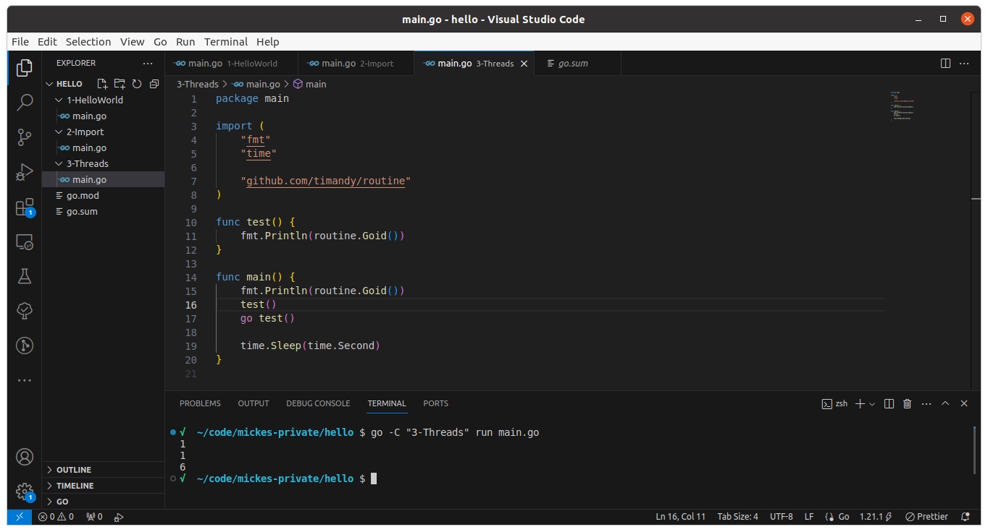
Go routines
To run any code in an own thread you just put the word ”go” before the code. We call this a goroutine. See example below for calling a function normally and for calling the same function as a goroutine (thread). To demo this we imported the timandy/routine package for printing something similar to a thread id.

Slide 34
Go routines
Worth noting from the demo above is that we need to add a sleep to the end of the main function. This is because the main function does not automatically wait for sub goroutines to finish. And if the main function exits, all goroutines will be abruptly terminated directly.
So, to ensure the goroutine have time to do its print, we added a sleep.

Slide 35
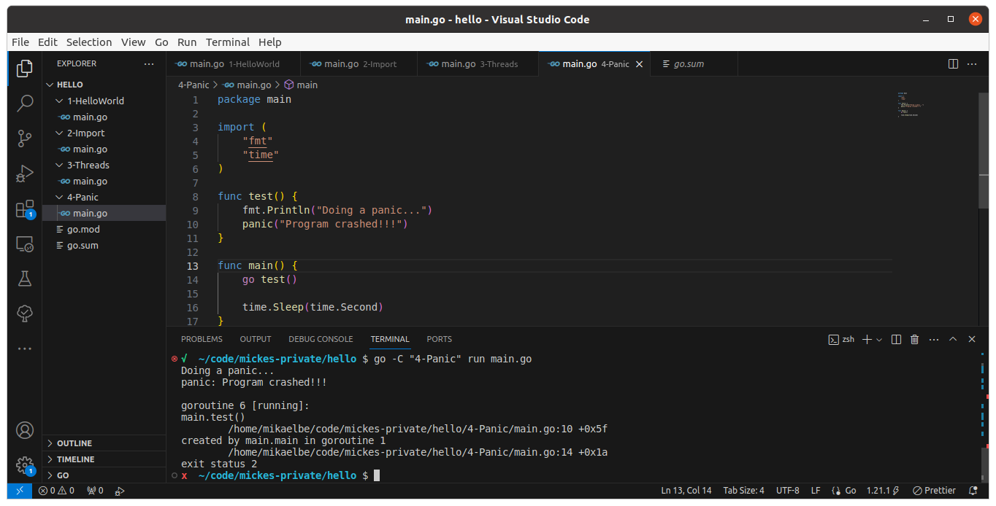
Panic
To force the program to crash in Go, we use a built in function called ”Panic”. This will crash, immediately terminate, the whole program including all goroutines and the main thread. Though, it can be prevented by “recover”, see later slides.

Slide 36
Defer
Go does not have try/catch.
But it has ”defer”!!
All defer functions that you declare will be guaranteed to execute at the end of the function it is declared in, even if your function crashes.
A downside with defer is that only defers occuring in the same goroutine as the crash, will be executed.
Multiple defer functions can be declared. The last one declared will be executed first, then the others (LIFO).

Slide 37
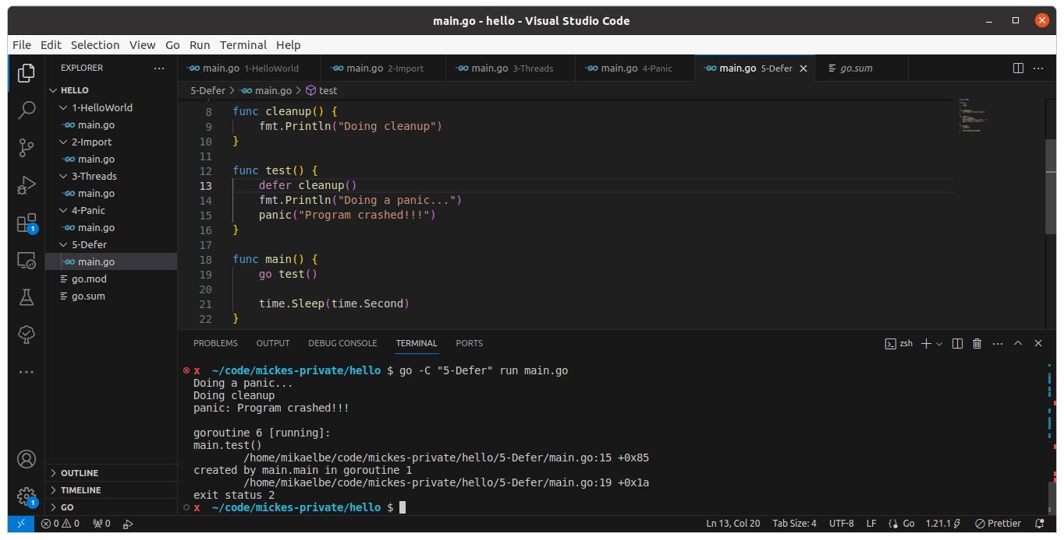
Defer
Example of a defer in a goroutine that crashes.

Slide 38
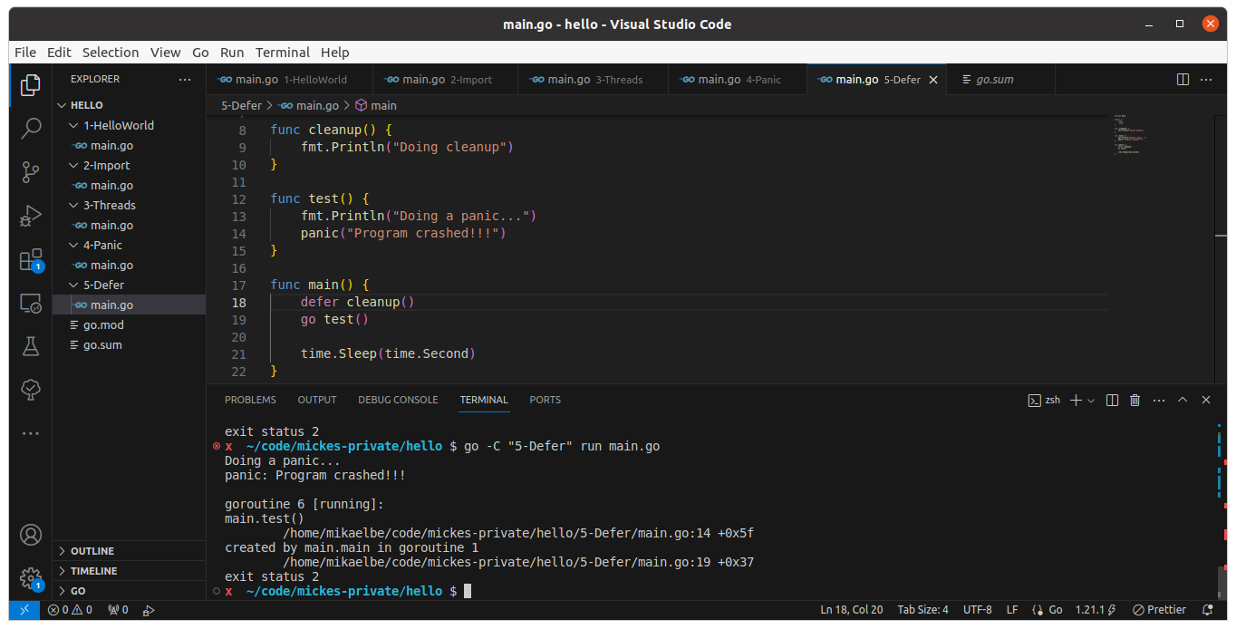
Defer
Example showing that the defer is not executed if a crash happens in another goroutine.

Slide 39
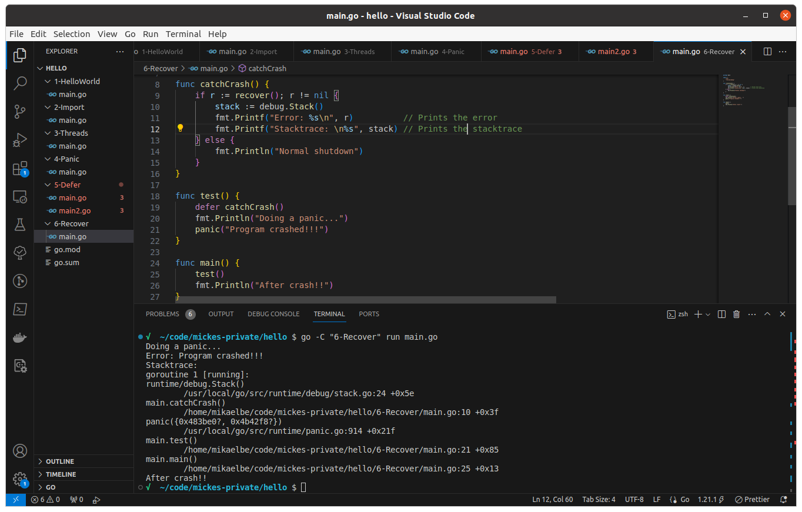
Recover
Recover from panic

Slide 40
Recover
If recover() is called, the panic is caught and it is not propagated up to main.
This means that only the crashing function ends after defer and the rest of the program continues.
If recover() is not called, the panic will cause the whole program to exit after the defer function is done. The error would then be reported on stderr.

Slide 41
Normal error handling
The Go idiomatic way, to handle errors without exception, is that each function should take care of its own problems and return an error variable along with the normal result.
When a function returns a value and an error, the caller checks the error to determine if the function completed successfully or if an error occurred. If the error is not nil, it indicates that an error occurred and the returned value should not be used.

Slide 42
Normal error handling
Example
// ReadFile reads a file and returns its content and an error if something goes wrong.
func ReadFile(file string) ([]byte, error) {
data, err := os.ReadFile(file)
if err != nil {
return nil, fmt.Errorf("failed to read file: %w", err)
}
return data, nil
}
func main() {
content, err := ReadFile("example.txt")
if err != nil {
fmt.Println("Error:", err)
return
}
fmt.Println("File content:", string(content))
}

Slide 43
Channels
A channel is used to communicate between goroutines and make your code event driven.
func main() {
// Create a channel to signal completion
done := make(chan bool)
// Start a goroutine that will do some work and then signal completion
go func() {
fmt.Println("Doing some work…")
time.Sleep(2 * time.Second) // Simulate work
fmt.Println("Work done!")
done <- true // Signal completion
}()
// Wait for the goroutine to signal completion
<-done
fmt.Println("Main function continues after goroutine completes.")
}

Slide 44
Channels
data := <- a // read from channel a
a <- data // write to channel a
Sends and receives to a channel are blocking by default.
If no receiver → Deadlock → panic.
You can declare channels to transfer any of the data types, like bool, string, int, struct, map, array, slice and even other channels.

Slide 45
Channels
Wait for several channels
func worker(name string, timer chan int) {
// Create a new random source with a seed
r := rand.New(rand.NewSource(time.Now().UnixNano()))
// Generate a random number between 1 and 10
rnd := r.Intn(10) + 1
time.Sleep(time.Second * time.Duration(rnd))
timer <- rnd
}
func main() {
a, b, c := make(chan int), make(chan int), make(chan int)
go worker("Analytics", a)
go worker("ACS", b)
go worker("IT", c)
// Wait for every worker to finish
worktime1, worktime2, worktime3 := <-a, <-b, <-c
fmt.Printf("Analytics finished in %ds\n", worktime1)
fmt.Printf("ACS finished in %ds\n", worktime2)
fmt.Printf("IT finished in %ds\n", worktime3)
}

Slide 46
Select
An example of a select statement in a goroutine that makes the goroutine close down if it receives either a signal on any channel or a timeout.
func main() {
shutdownChan := make(chan struct{})
go func(shutdownChan chan struct{}) {
select {
case <-shutdownChan:
fmt.Println("Shutdown signal received, terminating worker.")
// Perform any cleanup or finalization here
return
case <-time.After(10 * time.Second):
fmt.Println("Timeout reached, terminating worker.")
// Perform any cleanup or finalization here
return
}
}(shutdownChan)
// Do other stuff here…
close(shutdownChan) // This will trigger the shutdownChan case in the worker
}

Slide 47
Select
An example of a work competition.
func worker(name string, timer chan int) {
// Create a new random source with a seed
r := rand.New(rand.NewSource(time.Now().UnixNano()))
// Generate a random number between 1 and 10
rnd := r.Intn(10) + 1
time.Sleep(time.Second * time.Duration(rnd))
timer <- rnd
}
func main() {
a, b, c := make(chan int), make(chan int), make(chan int)
go worker("Analytics", a)
go worker("ACS", b)
go worker("IT", c)
// Only wait for the first to finish, or timeout
select {
case worktime1 := <-a:
fmt.Printf("Analytics finished in %ds\n", worktime1)
case worktime2 := <-b:
fmt.Printf("ACS finished in %ds\n", worktime2)
case worktime3 := <-b:
fmt.Printf("IT finished in %ds\n", worktime3)
case <-time.After(5 * time.Second):
fmt.Println("Timeout reached, no one finished in time.")
}
}

Slide 48
Waitgroup
To make the main function wait for sub goroutines it is common to use waitgroups, like below.
func worker(name string, wg *sync.WaitGroup) {
// Create a new random source with a seed
r := rand.New(rand.NewSource(time.Now().UnixNano()))
// Generate a random number between 1 and 10
rnd := r.Intn(10) + 1
time.Sleep(time.Second * time.Duration(rnd))
wg.Done()
}
func main() {
var wg sync.WaitGroup
wg.Add(1)
go worker("Analytics", &wg)
wg.Add(1)
go worker("ACS", &wg)
wg.Add(1)
go worker("IT", &wg)
// Wait for every worker to finish
wg.Wait()
fmt.Println("All workers have finished")
}

Slide 49
Leakage
A goroutine can not really be leaked in the meaning that it would continue to run on its own when the main function has exited. This is not the case. When the main function exits all goroutines are abruptly terminated automatically, not even their eventual defer functions are executed. They just stop exactly where they are.
However, if another function than main, starts a goroutine, and that function is terminated, the goroutine will continue to run in the background until all of its code is executed, or the main function ends. This is handled by the go runtime.
When you hear about goroutine leakage it is probably referring to a goroutine with an endless loop or that listens on a channel that noone will send to. But even those will be terminated when main exits, so they are not leaked outside program scope.
The example below looks like a goroutine leak but everything will be terminated when the main function returns.
func main() {
go func() {
ch := make(chan int)
<- ch // Read from channel (no deadlock)
}()
}

Slide 50
Context
If you need to do a graceful shutdown of a goroutine when the main program exits you should preferably use waitgroups in combination with contexts.
Contexts are often used to signal to all parts in the program that you are about to close down, so each goroutine can close down gracefully.
When you create a context you always inherit it from a parent context. The top context is the context.Background().
When you close a context the Done() is only called for that context and its sub contexts, not for parent contexts.

Slide 51
Context
func worker(ctx context.Context, wg *sync.WaitGroup) {
defer wg.Done()
for {
select {
case <- ctx.Done():
fmt.Println("Worker received stop signal, cleaning up!!")
return
default:
fmt.Println("Worker is doing some work…")
time.Sleep(time.Second * 1)
}
}
}
func main() {
ctx, cancel := context.WithCancel(context.Background())
var wg sync.WaitGroup
wg.Add(1)
go worker(ctx, &wg)
// Simulate some work on the main thread
time.Sleep(time.Second * 5)
cancel() // Signal the goroutine to stop
wg.Wait()
fmt.Println("All workers have finished")
}

Slide 52
Embed
Embeds any file into the Go binary at compile time.
Good for embedding images or text files.
Good for embedding frontend, like whole react project.
Access the files from your Go program without needing to read them from the file system at runtime.
Creates a self-contained application that includes all its necessary resources in one binary.

Slide 53
Embed
Use by adding the following line above a variable: ”//go:embed <file or folder>”.
(Note the underscore in the import below. This tells the go compiler that embed should be imported even though no exported field from the package is used.)
The variable can be of type string, []byte, or embed.FS
import _ "embed"
//go:embed hello.txt
var s string
import "embed"
//go:embed image/* template/*
var content embed.FS

Slide 54
Embed
Example of embedding and serving a web page
package main
import (
"embed"
"io/fs"
"log"
"net/http"
)
//go:embed public
var webContent embed.FS
var webContentRoot, _ = fs.Sub(webContent, "public")
func main() {
mux := http.NewServeMux()
mux.Handle("/", http.FileServer(http.FS(webContentRoot)))
err := http.ListenAndServe(":8080", mux)
if err != nil {
log.Fatal(err)
}
}

Slide 55
Inheritance
Composition instead of inheritance
No classes so inheritance is not really supported.
But it can be mimiced by embedded anonymous fields in structs.

Slide 56
Inheritance
type author struct {
firstName string
lastName string
}
func (a author) fullName() string {
return fmt.Sprintf("%s %s", a.firstName, a.lastName)
}
type blogPost struct {
title string
content string
author
}
func (b blogPost) details() {
fmt.Println("Title: ", b.title)
fmt.Println("Content: ", b.content)
fmt.Println("Author: ", b.fullName())
}

Slide 57
Polymorphism
Achieved with the help of interfaces.
type Income interface {
calculate() int
source() string
}
type CameraSales struct {
cameraType string
pricePerUnit int
salesAmount int
}
func (cs CameraSales) calculate() int {
return cs.pricePerUnit * cs.salesAmount
}
func (cb CameraSales) source() string {
return cb.cameraType
}
type AppSales struct {
appName string
profit int
}
func (as AppSales) calculate() int {
return as.profit
}
func (as AppSales) source() string {
return as.appName
}

Slide 58
Polymorphism
Achieved with the help of interfaces.
func main() {
project1 := CameraSales{cameraType: "Wallet", pricePerUnit: 9000, salesAmount: 1000}
project2 := AppSales{appName: "DID", profit: 2500000}
incomes := []Income{project1, project2}
calculateNetIncome(incomes)
}
func calculateNetIncome(ic []Income) {
var netincome int = 0
for _, income := range ic {
fmt.Printf("Income From %s = %d\n", income.source(), income.calculate())
netincome += income.calculate()
}
fmt.Printf("Net income of organization = %d\n", netincome)
}

Slide 59
Other
No ”while”, only ”for”.
No malloc!! Memory placement, heap/stack, is decided by the runtime. You should not think about this.
Json marchal/unmarchal
Very good info:
https://golangbot.com/learn-golang-series/

Slide 60
Thanks...

